Slide 1

Capstone Project
EDA ON AIRBNB
Airbnb, as in “Air Bed and Breakfast,” is a service that lets property owners rent out their spaces to travelers looking for a place to stay. Travelers can rent a space for multiple people to share, a shared space with private rooms, or the entire property for themselves

Slide 2
About Given Data Set:
We are given a data set from Airbnb which holds values related to the tourists looking for renting a space in New York City.
Not only hotels but Entire home/apt , Private Rooms or even Shared rooms.
We here will try to get the most out of this data so that it can prove useful for security, business decisions, understanding of customers' and providers' (hosts) behavior and performance on the platform, guiding marketing initiatives, implementation of innovative additional services and much more.

Slide 3
Data Summary:
This dataset has around 49,000 observations in it with 16 columns and it is a mix between categorical and numeric values.
Understanding Data:
id :indicates the unique id of an entry in data set
name : indicates names of listings area in New York City
host_id :indicates unique id for a host in New York City
host_name : shows the name of the host
neighbourhood_group: indicates names of the cities where these listings are present
neighbourhood: displays the names of different neighbouring cities for each neighbourhood_group
latitude: displays latitude values of a listing.
longitude: displays longitude values of a listing.
room_type: indicates the type of room available.
price: indicates the price.
minimum_nights: indicates minimum number of nights spent.
number_of_reviews: indicates total number of reviews for a particular listing.

Slide 4

Data Summary (cont)
reviews_per_month :indicates reviews per month for a particular listing.
calculated_host_listings_count : shows the count of each host for a certain listing
availability_365 : indicates the number of days a particular listing is available in a year.
These were all the columns given in the Airbnb data set…
Lets now analyze them and try to gather some useful intel !!

Slide 5
Work Flow :
So we will divide our work flow into following 3 steps:
●
Data Collection and Understanding
Data Cleaning and Manipulation
Exploratory Data Analysis(EDA)
EDA will be divided into following 3 analysis.
Univariate analysis: Univariate analysis is the simplest of the three analyses where the data you are analyzing is only one variable.
Bivariate analysis: Bivariate analysis is where you are comparing two variables to study their relationships.
Multivariate anlysis: Multivariate analysis is similar to Bivariate analysis but you are comparing more than two variables.

Slide 6
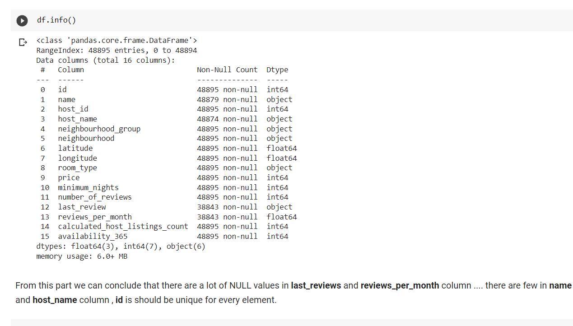
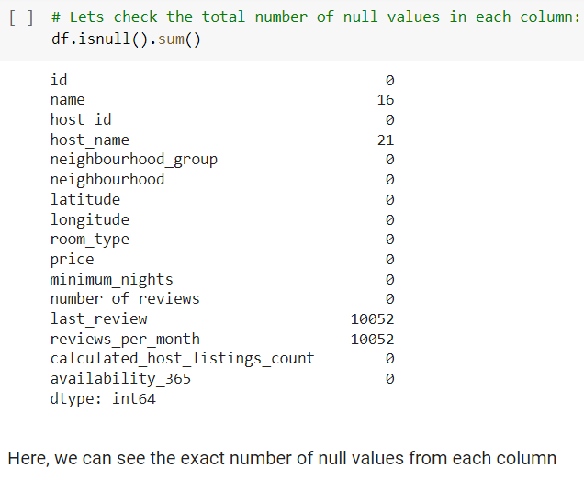
Data Cleaning and Manipulation:
We already have collected and understood our data so lets now directly jump into Data Cleaning and Manipulation:
Upon basic analysis we found a total of 4 columns with Null or missing values:
name
host_name
last_review
reviews_per_month
Total Missing or Null values in each column

Slide 7
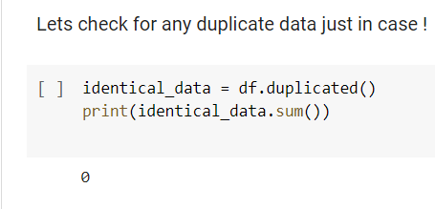

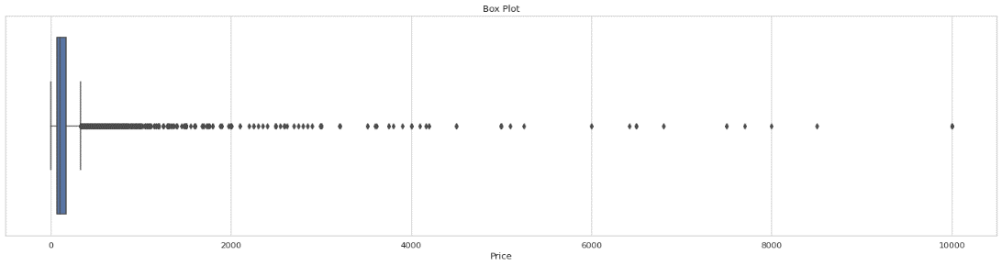
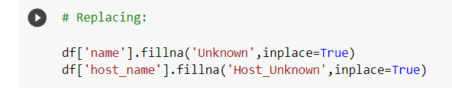
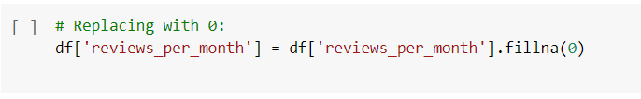
Data Cleaning and Manipulation:
Checking for duplicates:
A new column minimum_price has been added which will be the product of minimum_nights and price column
None Found
For ‘name’ and ‘host_name’ columns we replacing Null values with “Unknown” and “Host_Unknown”
Now, about outliers:
Replacing ‘reviews_per_month’ column’s missing values with 0:
Presence of a lot of outliers was detected in ‘price’ column via box-plot, even the mean was not visible….

Slide 8
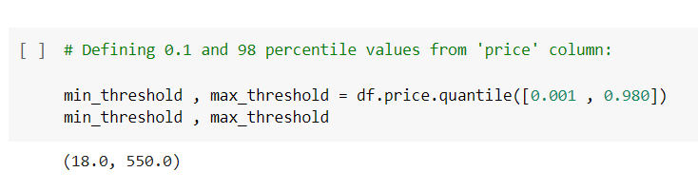
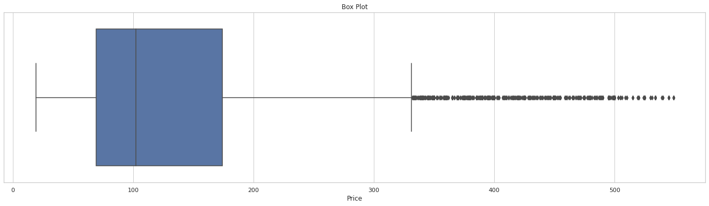
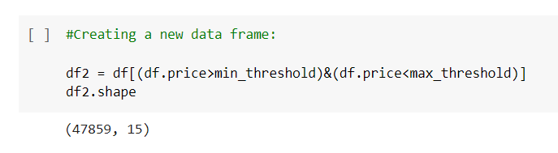
Data Cleaning and Manipulation:
So we tried removing outliers using Quantile approach:
Box-Plot now:
In this cell of code, we have assigned the lowest and highest limits/threshold and later just selected the values between these thresholds:
i.e values between 0.1 and 98 percentile were selected from the price column and a new Data Frame was created with these custom ‘price’ column values
Clearly a lot of outliers can still be seen here but now the mean, min, max and other quartile values were visible and that was quite enough for us to inspect the data further and perform EDA on it.

Slide 9
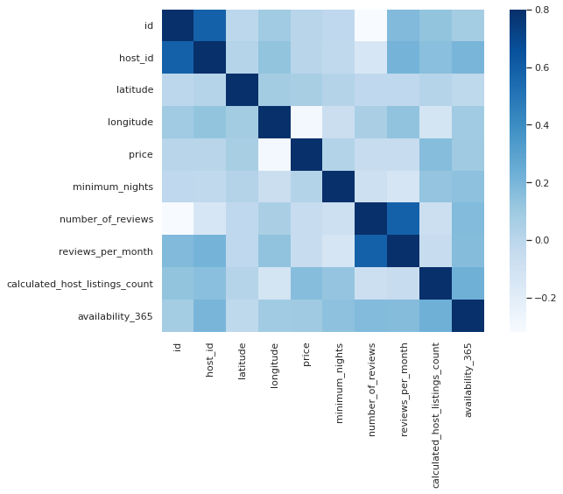
Exploratory Data Analysis: :
Data Correlation with each other:
➤ From the heatmap we can see the correlation between different columns that can affect a Airbnb listing.
➤ Also....
There's correlation among host_id to reveiws_per_month & availability_365. And there's noticiable correlation between min_nights to no_of_listings_count & availability_365.
➤ Price also shows some correlation with availability_365 & host_listings_count.
no_of_reviews and reviews_per_month gives almost the same information.

Slide 10
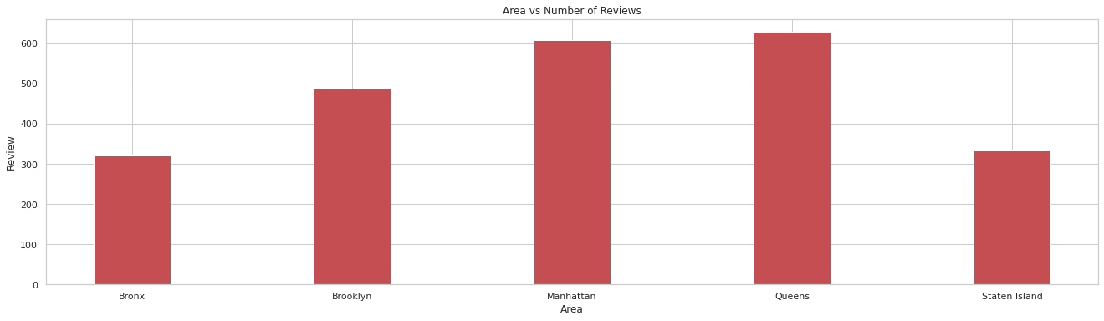
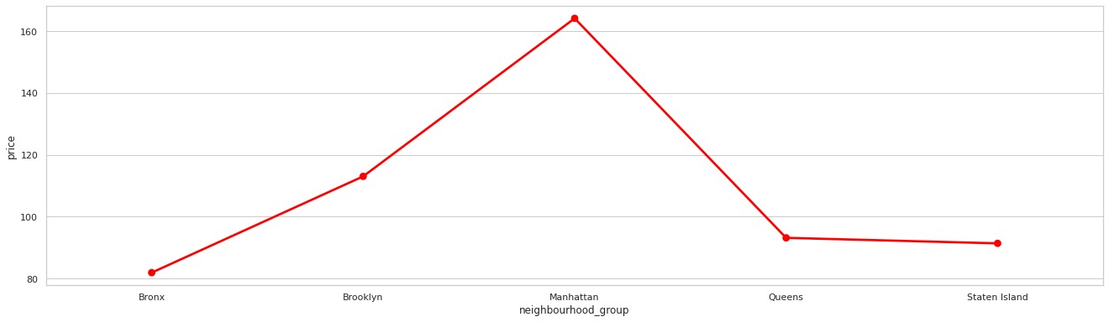
Exploratory Data Analysis: (Bi-Variate Analysis)
Number of Total Reviews per Neighbourhood Group
AVERAGE PRICE OF DIFFERENT NEIGHBOURHOOD GROUPS
Conclusions:
Conclusions:
People like staying in Queens the most as they have the highest total reviews ≈630
Manhattan is the 2nd most reviewed city with a total review score of ≈608
Brooklyn is at 3rd with ≈489 Total reviews.
Then Staten island with ≈334 Total reviews.
And Bronx is the least reviewed city in the entire New York.
Cost of living in Manhattan is the highest i.e ≈165
Then in Brooklyn which is ≈114
Queens comes at third place with ≈94 cost of living
Then Staten island with ≈92
And it is the cheapest in Bronx which is ≈82

Slide 11
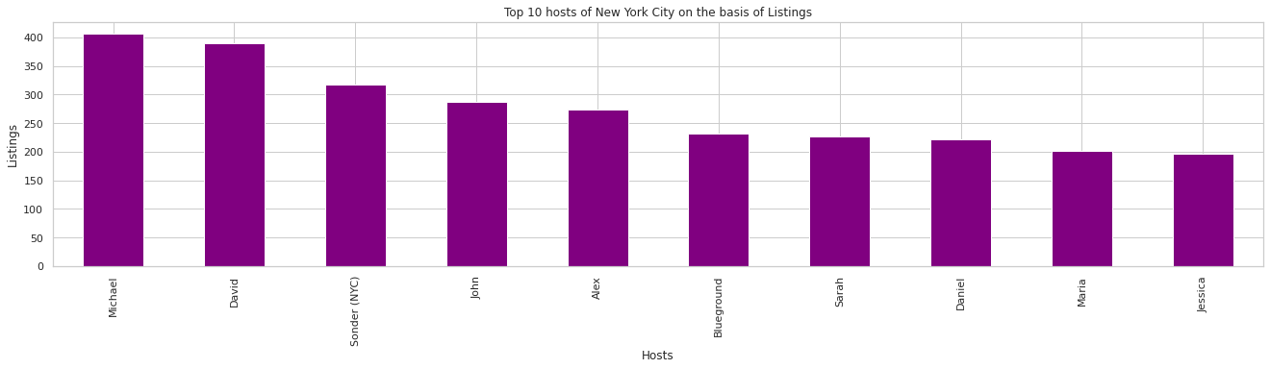
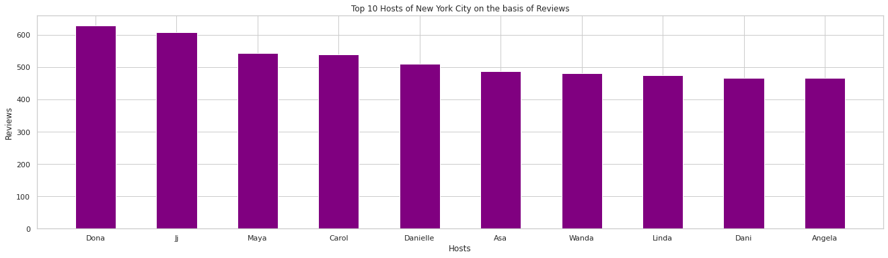
Exploratory Data Analysis: (Bi-Variate Analysis)
Conclusions:
Michael holds the most number of listings properties ≈408 in entire New York City follower by David , Sonder (NYC) and others.
TOP 10 Hosts on the basis of Listings
Conclusions:
However even after holding the most listings Dona is the most liked host of entire NYC with a total reviews of ≈630
Also, we found out that a single host can have multiple listings over every other Neighbourhood Group with different host id’s:
TOP 10 Hosts on the basis of Reviews

Slide 12
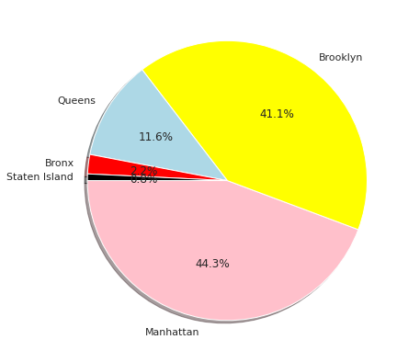
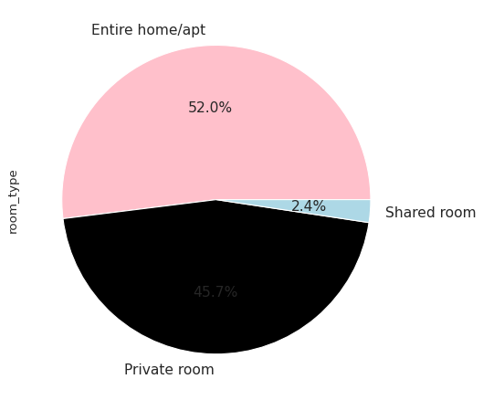
Exploratory Data Analysis: (Bi-Variate Analysis)
Total percentage of each room type in NYC
Total percentage of each neighborhood group in NYC
Conclusions:
Conclusions:
Total Percentage of each room type in entire NYC is:
Entire home/apt = 51.3%
Private room = 46.3%
Shared room = 2.4%
Total Percentage of area under each neighbourhood group in NYC is:
Manhattan = 43.7%
Brooklyn = 41.5%
Queens = 11.8%
Bronx = 2.3%
Staten island = 0.8%

Slide 13
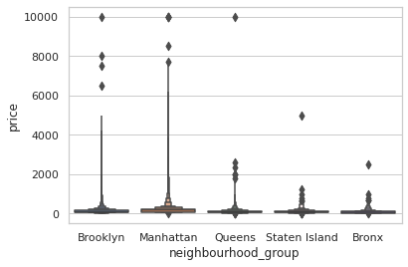
Exploratory Data Analysis: (Bi-Variate Analysis)
Average Price VS Neighborhood groups
Conclusions:
It is clear that Manhattan has the highest average of price followed by Brooklyn , Queens and Staten Island We can say that Bronx is the most affordable or the cheapest one in the entire neighbourhood_group in NYC !

Slide 14
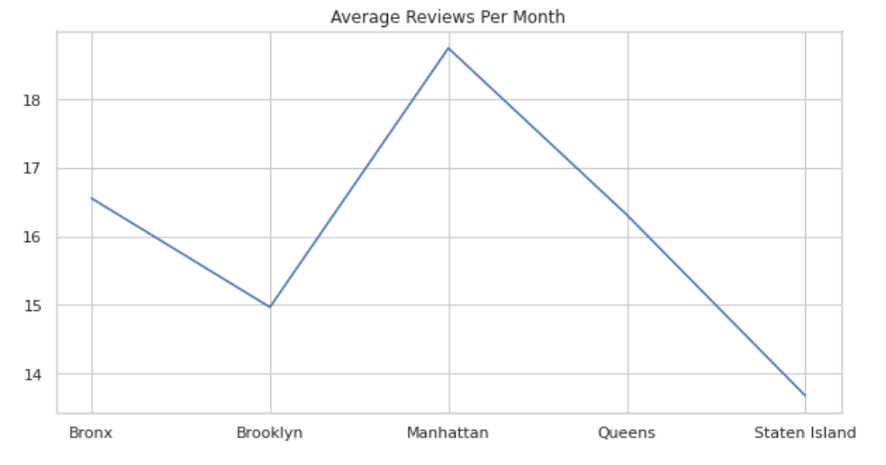
Average Reviews per Month Graph
Exploratory Data Analysis: (Bi-Variate Analysis)
Conclusion:
Descending order of Average Reviews per month received
Manhattan
Bronx
Queens
Brookly
Staten Island

Slide 15
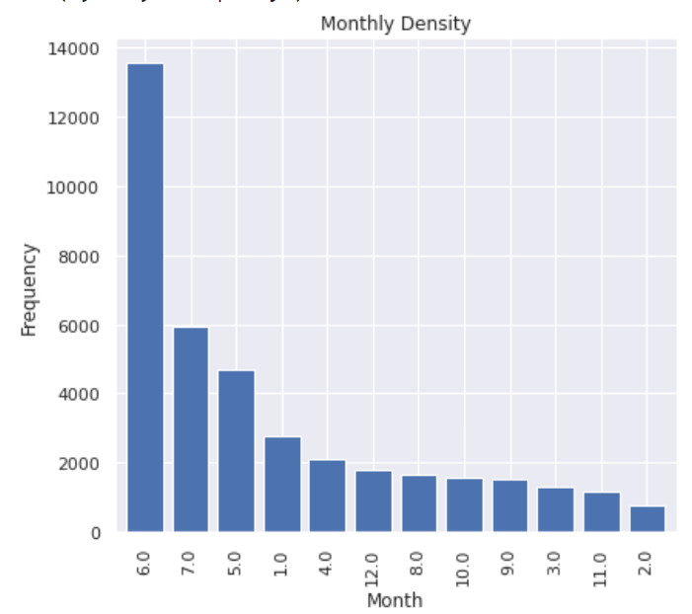
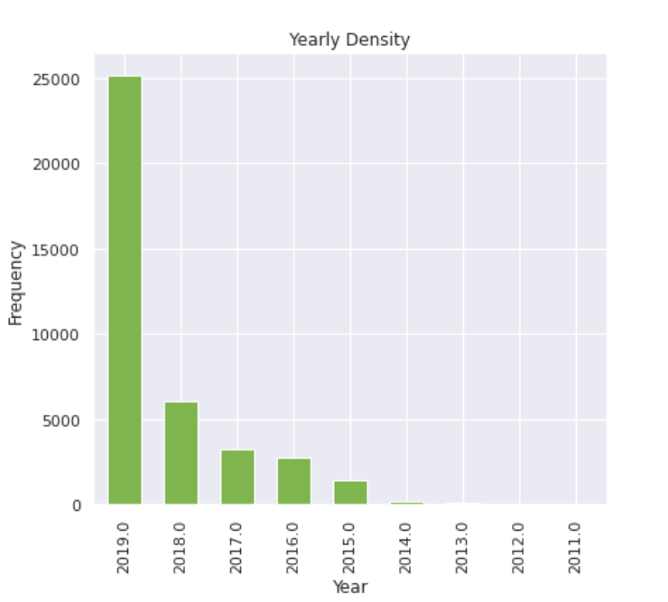
Customer Frequency (Monthwise and Yearwise)
Exploratory Data Analysis: (Bi-Variate Analysis)
Conclusion:
June was the Busiest month followed by July.
February was the least Busy.
Conclusion:
20109 was the Busiest year followed by 2018.
2011 was the least Busy.

Slide 16
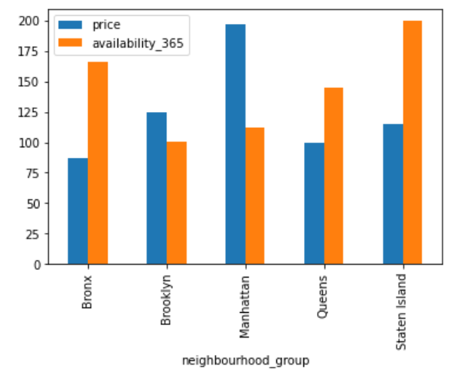
Mean Price and Availability Graph
Exploratory Data Analysis: (Multi-Variate Analysis)
Conclusion:
Best suited places for customers according to ranking will be
Bronx
Queens
Staten Island
Brookly
Manhattan

Slide 17
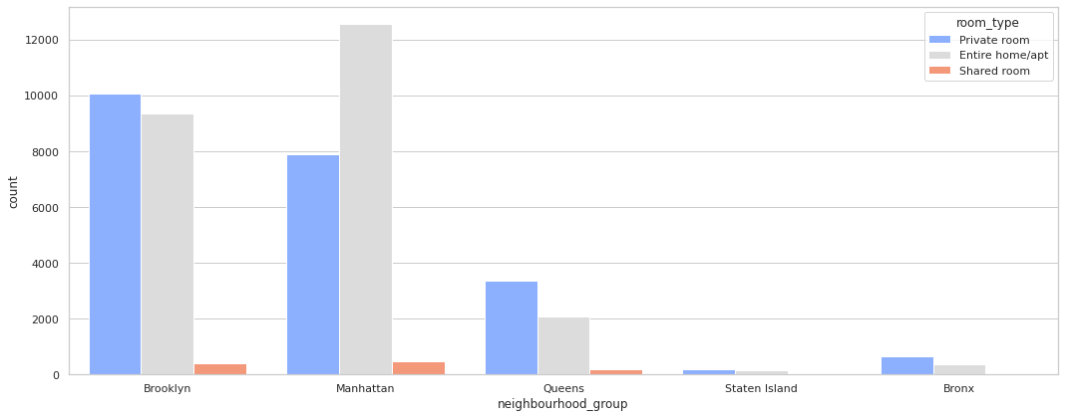
Exploratory Data Analysis: (Multi-Variate Analysis)
Total listings of each room type in each neighbourhood group in NYC
Conclusions:
Total number of room_type listings in each neighbourhood_group:
Entire home/apt:
➤Manhattan ≈13000
➤Brooklyn ≈9500
➤Queens ≈2100
➤Bronx ≈400
➤Staten island ≈100
Private room:
➤Brooklyn ≈10000
➤Manhattan ≈8000
➤Queens ≈3500
➤Bronx ≈800
➤Staten island ≈200
Shared room:
➤Manhattan ≈500
➤Brooklyn ≈300
➤Queens ≈200
➤Bronx and Staten island with almost negligible shared room type listings

Slide 18
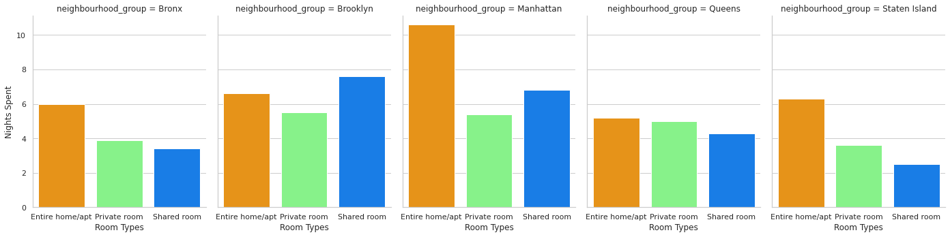
Exploratory Data Analysis: (Multi-Variate Analysis)
Average minimum nights spent in each room_type in each neighbourhood_group
Conclusions:
Average Minimum Nights spent in room_type in each neighbourhood_group:
Entire home/apt:
➤Manhattan ≈11
➤Brooklyn ≈7
➤ Staten island ≈7
➤Bronx ≈7
➤Queens≈6
Private room:
➤Brooklyn ≈6
➤Manhattan ≈6
➤Queens ≈6
➤Bronx ≈4
➤Staten island ≈4
Shared room:
➤ Brooklyn ≈8
➤ Manhattan ≈7
➤Queens ≈5
➤Bronx ≈4
➤Staten island ≈3

Slide 19
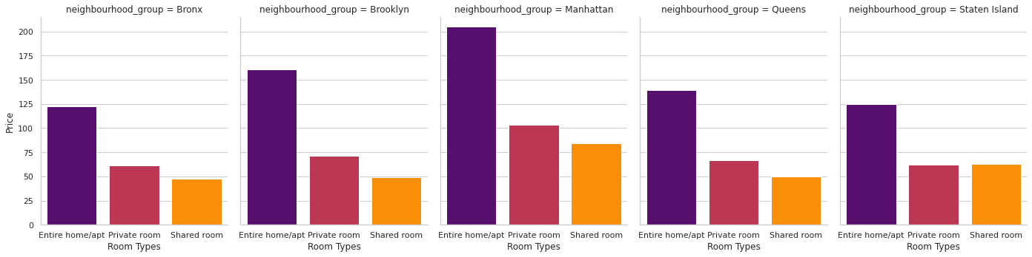
Exploratory Data Analysis: (Multi-Variate Analysis)
Average price of each room_type in each neighbourhood_group
Conclusions:
Average price of each room_type in each neighbourhood_group:
Entire home/apt:
➤ Manhattan ≈206
➤ Brooklyn ≈161
➤ Queens≈140
➤ Staten island ≈125
➤ Bronx≈123
Private room:
➤ Manhattan ≈104
➤ Brooklyn ≈72
➤ Queens ≈68
➤ Staten island ≈63
➤ Bronx ≈62
Shared room:
➤ Manhattan ≈85
➤ Staten island ≈64
➤ Queens ≈51
➤ Brooklyn ≈50
➤ Bronx ≈48

Slide 20
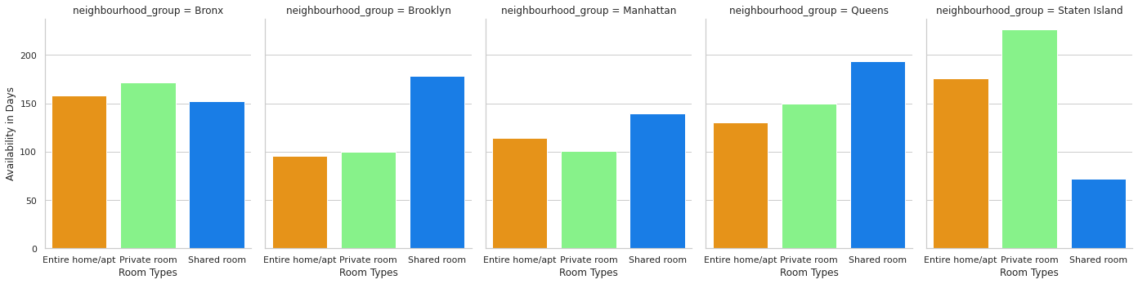
Exploratory Data Analysis: (Multi-Variate Analysis)
Average availability of each room_type in each neighbourhood_group
Conclusions:
Average availability of each room_type in each neighbourhood_group:
Entire home/apt:
➤ Staten island ≈176 days
➤ Bronx ≈159 days
➤ Queens≈131 days
➤ Manhattan≈114 days
➤ Brooklyn≈96 days
Private room:
➤ Staten island ≈227 days
➤ Bronx ≈172 days
➤ Queens≈150 days
➤ Manhattan≈101 days
➤ Brooklyn≈100 days
Shared room:
➤ Queens ≈194 days
➤ Brooklyn ≈179 days
➤ Bronx ≈153 days
➤ Manhattan ≈140 days
➤ Staten island ≈72 days

Slide 21
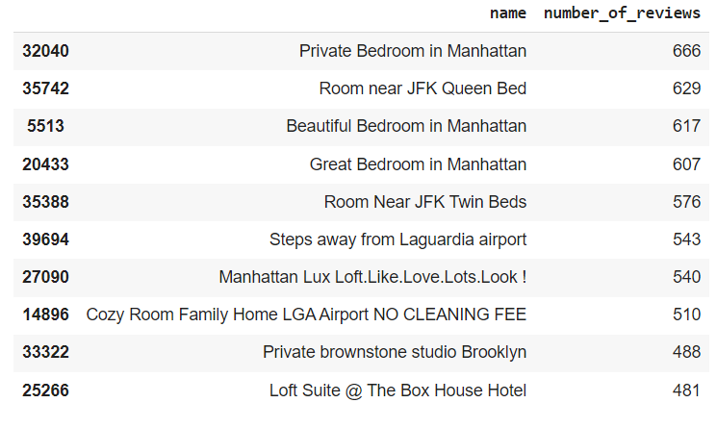
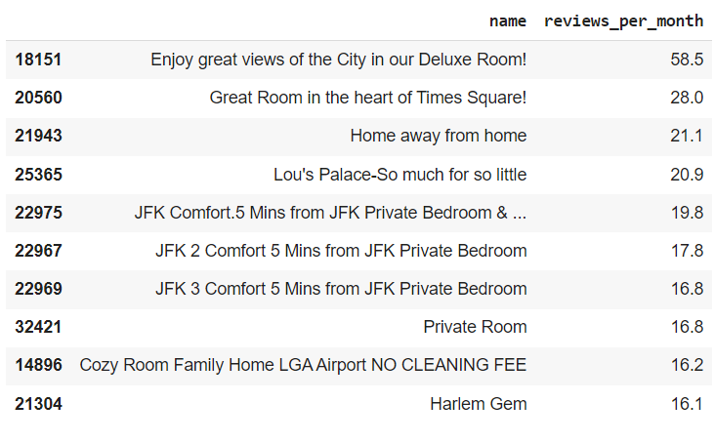
Exploratory Data Analysis:
List of TOP 10 name of listings in entire NYC as per total reviews:
Private Bedroom in Manhattan is the most famous listing property as per total reviews ≈667 followed by Room near JFK Queen Bed with ≈630 total reviews and others...
List of TOP 10 name of listings in entire NYC as per reviews per month:
On the basis of monthly reviews Enjoy great views of the City in our Deluxe Room! is at the top with a total of ≈59 reviews per month.

Slide 22
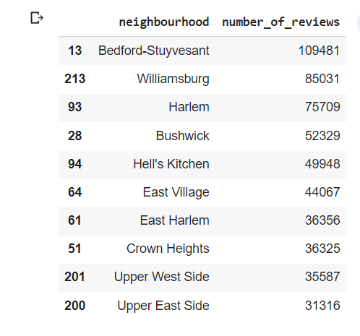
Exploratory Data Analysis:
TOP 10 Neighbourhood on the basis of Total number of reviews
Top neighbourhood is Bedford-Stuyvesant with total reviews of ≈109482
Williamsburg is at 2nd with a total of ≈85032 reviews followed by Harlem and others

Slide 23
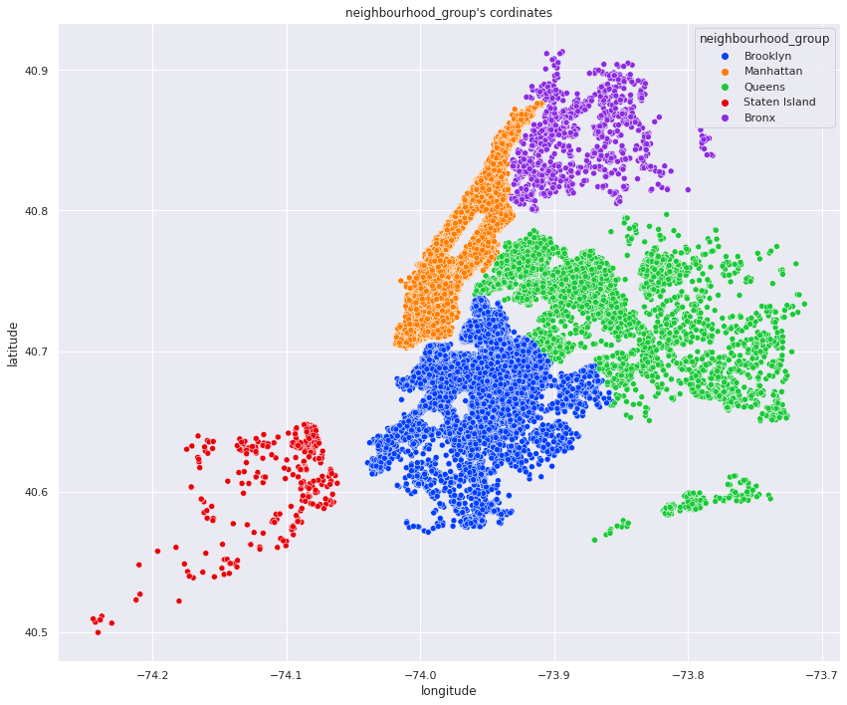
Exploratory Data Analysis:
Latitude & Longitude values of each listing in each neighbourhood group in entire NYC
Latitude & Longitude values of each listing property of each neighbourhood group is shown here via scatterplot ….

Slide 24
Challenges Faced:
➧ The first challenge was to make the data set ready for EDA by fixing NULL & NaN values , which we did by replacing values in few columns and dropping/deleting the others.
➧ Next challenge was to remove the outliers without doing so, the data could never be analyzed.
We removed the outliers by Quantile approach which makes the data set just ready for exploration…
➧ Using Interquartile Range(IQR) Formula (Interquartile range = Upper Quartile – Lower Quartile) for removing outliers was a better approach but Quantile method was just fine for our basic operations.

Slide 25
Overall Conclusion:
We were given a csv file containing a data set from Airbnb, we started our Analysis by:
➧ First having a brief overlook at given Data Set ,then we fixed Null & NaN values.
➧ After that we tried dealing with the Outliers using Quantile approach.
Which means to assign a minimum and a maximum threshold and then only catching the values in between them.
➧ Created and overviewed Box Plot to get a basic idea of mean, max, min and quartiles values.
➧ Created a heat map and tried to get the correlations between the columns.
➧ Concluded the relationship between the Hosts and Neighbourhood Areas in NYC !
➧Performed some Bi-Variate Analysis among Neighbourhood Groups , Prices and Reviews and plotted some Bar Graphs for the same.
(Bi-Variate Analysis: comparing two different variables to study their relationship)
➧Figured out Top Airbnb Hosts on the basis of Listings and Reviews both and showed them using Bar Graphs.

Slide 26
Overall Conclusion: (cont)
➧Saw the Total Percentage listings of each Room type and each Neighbourhood Groups in NYC using pie plot.
➧ Observed Descending order of Average Reviews per month received
➧ Concluded the busiest Month and Year
➧ Concluded best suited Places for visitors on the basis of Price & Availability
➧ We then went on performing some Multi-Variate Analysis and using CountPlot we figured out :
(Multi-Variate Analysis: is quite similar to Bi Variate Analysis but here we compare more than 2 variables at once)
➲ Average Nights spent in each Room Type for all Neighbourhood Cities
from Longest to Shortest.
➲ Average Price of each Room Type for all Neighbourhood Cities in NYC from Highest to Lowest.
➲ Average Availability of each Room Type for all Neighbourhood Cities in NYC in a year.
➧ Sorted out TOP 10 listings Names according to the Reviews of people.
➧ Sorted out TOP 10 Neighbourhood Cities according to the Reviews of people.
➧ And finally played around with Latitude & Longitude a bit and represented them using Scatterplot.

Slide 27
THANKS !

